Slide 1

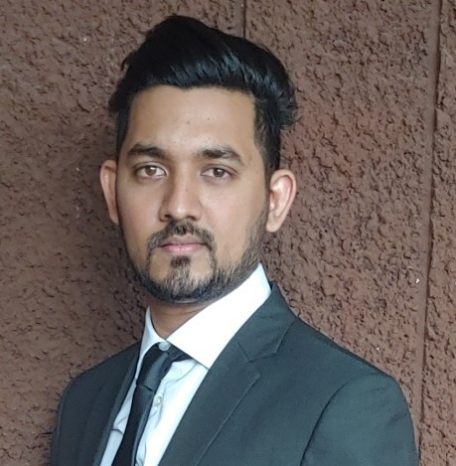

Experience
Areas of expertise
Functional
Onshore / Offshore Coordination
Scrum Master
Agile / Design Thinking
Industries
Food/Products
Energy
Telecommunication
Technical
Azure DevOps
Microsoft SQL Server Management Studio
Azure Data Factory
Azure Analysis Services
Azure Databricks
PowerBI
GIT
SAP BW
SAP BO
SAP ABAP (BW)
SAP BexAnalyser
SAP BexDesigner
SAP BODS
SAP SolMan – ChaRM
SAP BODS Developer (Jan 2016 – Feb 2017)
Design ETL solutions for a client from food industry
SAP BW/BO Developer (Feb 2017 – Dec 2019)
Design BI solutions for a client from energy and telecom industry
MS BI Developer (Jan 2020 – Oct 2020)
Design BI solutions in Azure for a client from energy industry.
Data Engineer (Oct 2020 – To Date)
Design BI solutions in Azure for a client from energy industry.
Vishanand Doyal
Application Development Analyst
Accenture Mauritius IT Solution Delivery Centre, Cyber City Ebène, Mauritius.
Professional background
IT graduate with 4.5+ years of experience in BI/Data analytics/ETL/Big Data
Education
Post Graduate Diploma in IT
BCS, The Chartered Institute for IT (2018)
Scrum Fundamentals Certified (SCRUMstudy)

Slide 2

Current Experience
Data Engineer
Skills & Technologies
I am responsible for the following project activities:
Collaborating with the Business Analyst to fully understand the requirements and making sure that the features fulfill the business needs.
Creation of tables, views and stored procedure via sql scripts on Microsoft SQL Server Management.
Creation of Notebooks on Azure Databricks to transform flat files on the blob from raw state to curated form which is loaded into the refined. Load data from refined tables into the datamart(dimensions and fact tables).
Creation of Pipelines using Azure Data Factory to run notebooks.
Creation of cubes on Azure Analysis Services.
Creation of PowerBI reports to validate the results after developments.
Using the tools on AzureDevops to: (1) Breakdown User Stories into tasks and plan sprints, (2) Manage git repositories, for peer reviewing and collaborating with other team members, (3) Creating and using pipelines to ease integration and deployment of artifacts.
Coach new joiners and help them integrate the team through knowledge transfer and providing support on technical issues.
Skills
Teamwork
Analysis & solutions design
Scrum
Technical
Azure DevOps
Microsoft SQL Server Management Studio
Azure Databricks
Azure Data Factory
Azure Analysis Services
PowerBI
GIT

Slide 3
Past Experience
MS BI Developer
Skills & Technologies
I am responsible for the following project activities:
Collaborating with the Business Analyst to fully understand the requirements and making sure that the features fulfill the business needs.
Creation of tables, views and stored procedure via sql scripts on Microsoft SQL Server Management.
Creation of Pipelines using Azure Data Factory to load data into staging tables from flat files on the blob.
Creation of cubes on Azure Analysis Services.
Creation of PowerBI reports to validate the results after developments.
Using the tools on AzureDevops to: (1) Breakdown User Stories into tasks and plan sprints, (2) Manage git repositories, for peer reviewing and collaborating with other team members, (3) Creating and using pipelines to ease integration and deployment of artifacts.
Demo at the end of each sprint to display project features developed to stakeholders.
Retro at the end of each sprint evaluate sprint.
Coach new joiners and help them integrate the team through knowledge transfer and providing support on technical issues.
Skills
Teamwork
Analysis & solutions design
Scrum
Technical
Azure DevOps
Microsoft SQL Server Management Studio
Azure Data Factory
Azure Analysis Services
PowerBI
GIT

Slide 4
SAP BODS Developer
Past Experience
Skills & Technologies
I am responsible for the following project activities:
Data extraction from old systems, application of transformations necessary and load them into SAP via IDocs or LSMW files.
Perform an in-depth analysis of the functional documentation and create respective technical documentation.
Create BODS package.
Perform required test cases.
Skills
Teamwork
Analysis & solutions design
Scrum
Technical
SAP BW
SAP BO
SAP ABAP (BW)
SAP BexAnalyser
SAP BexDesigner
SAP BODS
SAP SolMan – ChaRM
SAP BW/BO Developer
I am responsible for the following project activities:
Creation of BI solution from SAP extractors to Cube.
Loading of Data from SAP ECC, by building / configuring standard extractors on the ECC system and replicating them on the BW system.
Loading of Data from flat files in BW system.
Creation of transformation rules with ABAP routines to be able to manipulate data.
Creation of DataStoreObjects, Cubes, multiproviders, Openhub and Infosets.
Creation of queries based on multiproviders / cubes using SAP BEX Query designer.
Creation of reports based on BEX queries using SAP BO (WEBI) and Analysis for Office.
Modification of SAP roles

